Slide 1

Kashmir Conflict: Past, Present and the Future

Slide 2
Introduction
Kashmir conflict is a territorial conflict between India and Pakistan which started just after partition of India. India and Pakistan have fought three wars over Kashmir, including the Indo-Pakistani Wars of 1947, 1965 and 1999.

Slide 3
Historical Background
In1846, under the terms of the Treaty of Amritsar, the British sold the beautiful valley of Kashmir to the Hindu Dogra ruler, Gulab Singh. As Maharaja of Jammu and Kashmir, he was at last able to include Kashmir as the ‘jewel’ among his other territorial possessions, which included Jammu, Ladakh, Baltistan and numerous hill states, through which ﬂowed the river Indus and its tributaries to the east.
a century later, the sub-continent was partitioned at independence in 1947, Maharaja Hari Singh, Gulab Singh’s great-grandson, could not decide whether to join the new dominion of Pakistan or India. he ﬁnally agreed to join India. War between India and Pakistan was ﬁnally halted in 1949 by a ceaseﬁre supervised by the recently founded United Nations.

Slide 4
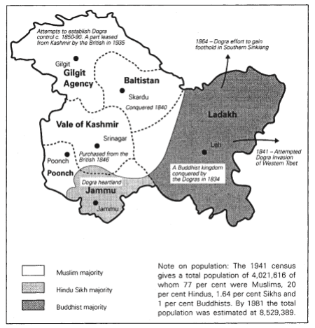

Slide 5
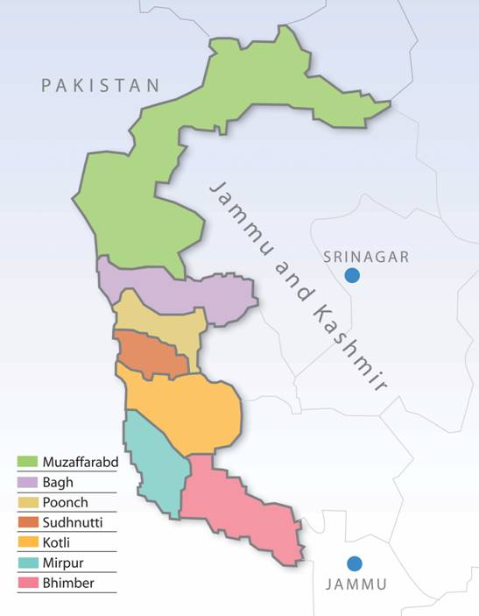

Slide 6
For over ﬁfty years, India and Pakistan have fought over Jammu and Kashmir both on the battleﬁeld and at the negotiating table; both countries wanted to absorb it within their borders, neither of them has succeeded in doing so entirely. One-third of the former princely state is administered by Pakistan, known as ‘Azad’ (Free) Jammu and Kashmir and the Northern Areas; two-thirds, known as the state of Jammu and Kashmir, are controlled by India; this area includes the regions of Ladakh, Jammu and the prized valley of Kashmir.
What distinguishes the Kashmir conﬂict from other regional disputes is that, in order to effect the ceaseﬁre, in 1948 the Indian government made a formal complaint to the Security Council of the United Nations against Pakistan’s ‘aggression’. The complaint against Pakistan in an international forum turned a dispute between two countries into an issue which demanded international attention. The recommendations of the United Nations, formulated into three resolutions passed in 1948 and 1949, also formalized the presence of a third party into the debate: the wishes of the people who lived in the land over which India and Pakistan were ﬁghting. All three resolutions recommended that India and Pakistan should proceed with holding a plebiscite, as already agreed by the Governments of India and Pakistan, so that the people themselves could decide their future.

Slide 7
The Plebiscite
That the plebiscite was never held
Firstly as a prerequisite, Pakistan was required to withdraw its forces from the territory.
Secondly, it was clear that the Indian government only agreed to hold a plebiscite at a time when it was conﬁdent that the majority would conﬁrm union with India.
In the event, Pakistan’s refused to vacate the territory first which gave India the excuse to back out on its commitment to hold a plebiscite;

Slide 8
Simla Agreement
The immediate outcome of the War of 1971 between India and Pakistan was the change of government in Pakistan and Zulfiqar Ali Bhutto, the majority party leader of West Pakistan assumed power on December 20, 1971. The War of 1971 resulted in the dismemberment of East Pakistan. Pakistan had lost almost 54% of its population and 93,000 of its soldiers and civilians were in Indian possession. Therefore, the new government’s initial challenges were to come out the state of emergency and resolve the matter of POW’s as soon as possible.

Slide 9
Main clauses of Simla Agreement
On July 2, 1972 both countries reached an agreement. :
Both countries would put an end to conflict and confrontation and would work for promotion of friendly relations and peace. They agreed to follow United Nations Charter to govern their relations and affirmed to respect each other’s national unity, political independence and territorial integrity.
Both Governments agreed to avert hostile propaganda against each other.
For the restoration of normal relations both the governments agreed to resume communications and promote travel facilities. Both agreed for cooperation in economic and cultural activities.
Both agreed to respect the line of control between Jammu and Kashmir resulting from the ceasefire of December 17, 1971.
The withdrawal of forces of both countries would come into effect within the 30 days of agreement’s enforcement.

Slide 10
Kargil War
In mid-1999, Mujaheedeen and Pakistani soldiers from Pakistani Kashmir enterd Jammu and Kashmir. During the winter season, Indian forces regularly move down to lower altitudes, as severe climatic conditions makes it almost impossible for them to guard the high peaks near the Line of Control. They took advantage of this and occupied vacant mountain peaks in the Kargil range overlooking the highway in Indian Kashmir that connects Srinagar and Leh. By blocking the highway, they could cut off the only link between the Kashmir Valley and Ladakh. This resulted in a large-scale conflict between the Indian and Pakistani armies. Fears of the Kargil War turning into a nuclear war provoked the then-United States President Bill Clinton to pressure Pakistan to retreat. The Pakistan Army withdrew their remaining troops from the area, ending the conflict. India reclaimed control of the peaks, which they now patrol and monitor all year long.

Slide 11
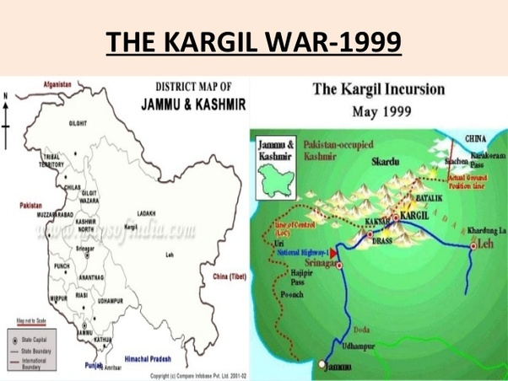

Slide 12
President Pervez Musharraf
In December 2006, Pakistan’s President Pervez Musharraf presented what was called as “out of box” solution to resolve the issue of Jammu & Kashmir.
Musharraf’s four point formula for the Kashmir conflict included:
Kashmir will have the same borders but people will be allowed to move freely back and forth in the region.
The region will have a self-governance or autonomy, but not independence.
Troops will be withdrawn from the region in a staggered manner.
A joint supervision mechanism will be set up, with India, Pakistan and Kashmir. Musharraf offers Kashmir Solution.

Slide 13
Burhan Wani
Indigenous movement

Slide 14
Article 370 & 35A
Prime Minister Narendra Modi and the Hindu nationalist Bharatiya Janata Party (BJP) had long opposed Article 370 and revoking it was in the party's 2019 election manifesto.
Tens of thousands of additional Indian troops were deployed, a major Hindu pilgrimage was cancelled, schools and colleges were shut, tourists were ordered to leave, telephone and internet services were suspended and regional political leaders were placed under house arrest.
The government then stunned everyone by saying it was revoking nearly all of Article 370, which 35A is part of and which has been the basis of Kashmir's complex relationship with India for some 70 years.

Slide 15
What are Articles 370 and 35A? Why they are important for J&K
Article 370:
The law of citizenship, ownership of property, and fundamental rights of the residents of Jammu & Kashmir is different from the residents living in rest of India. Under Article 370, citizens from other states cannot buy property in Jammu & Kashmir. Under Article 370, the Centre has no power to declare financial emergency.
It is important to note Article 370(1)(c) explicitly mentions that Article 1 of the Indian Constitution applies to Kashmir through Article 370. Article 1 lists the states of the Union. This means that it is Article 370 that binds the state of J&K to the Indian Union. Removing Article 370, which can be done by a Presidential Order, would therefore make the state independent of India.

Slide 16
Article 35A:
It gives the Jammu & Kashmir Legislature full discretionary power to decide who the 'permanent residents' of the state are. It gives them special rights and privileges regarding employment with the state government, acquisition of property in the state, settling in the state, and the right to scholarships and other forms of aid that the state government provides. It also allows the state legislature to impose any restrictions upon persons other than the permanent residents regarding the above.
To guarantee these special rights and privileges, the Article says no act of the state legislature that comes under it can be challenged for violating the Constitution or any other laws.

Slide 17
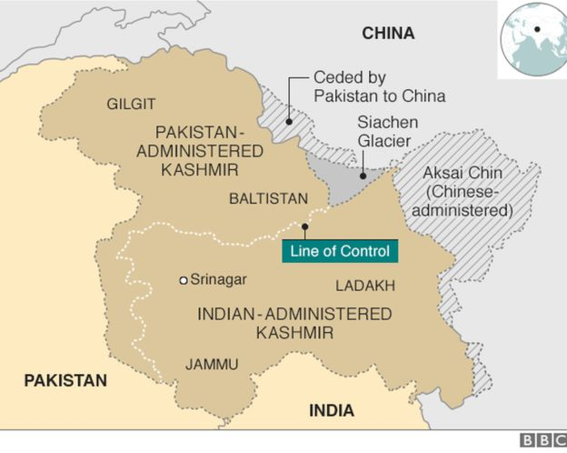

Slide 18
What’s Behind the Latest India-China Border Tensions?
Tensions along the China-India border high in the Himalayas have flared again in recent weeks.
Indian officials say the latest row began in early May, when Chinese soldiers entered the Indian-controlled territory of Ladakh at three different points, erecting tents and guard posts. They said the Chinese soldiers ignored repeated verbal warnings to depart, triggering shouting matches, stone-throwing and fistfights. China has sought to downplay the confrontation while providing little information.

Slide 19
Conclusion
Must decide according to UN Resolutions and will of Kashmiris

